Slide 1
Spike Sorting

Slide 2
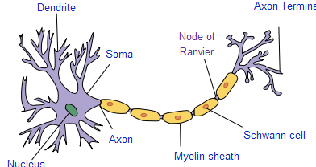
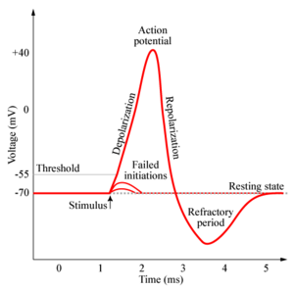
Background
Neuron
  cell in the nervous system that processes and transmits information by electrochemical signaling
  dendrite, soma, and axon
Spike (Action Potential)
  self-regenerating wave of electrochemical activity that allows nerve cells to carry a signal over a distance

Slide 3
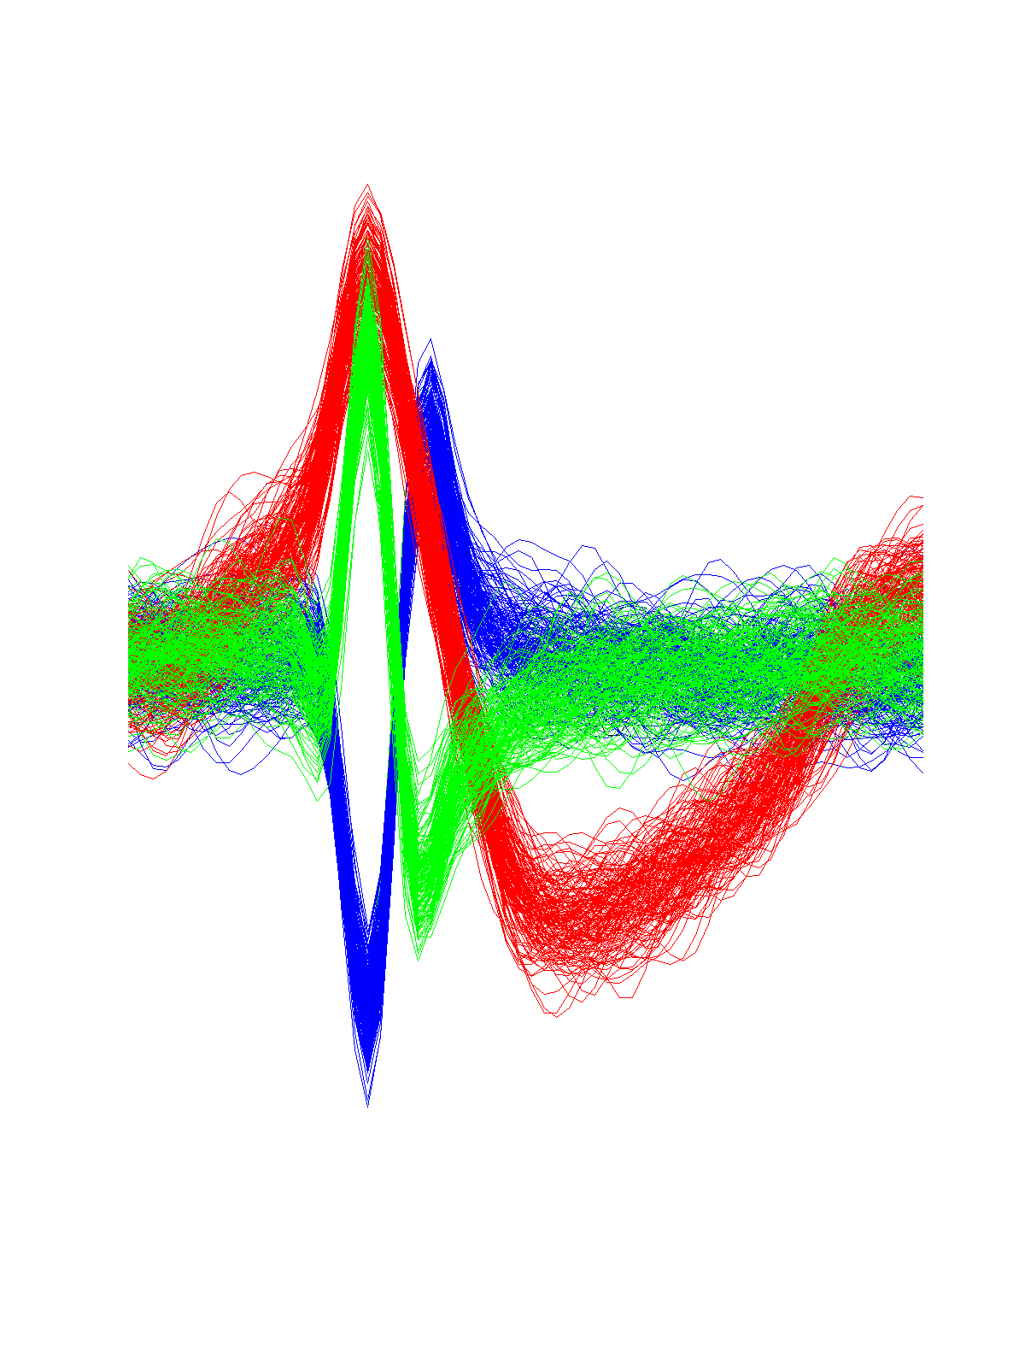
Spike Sorting
Detection and classification process of spikes from extracellular recordings of neurons using electrodes
We need to decide which and how many spikes are present in the collected data
Example

Slide 4
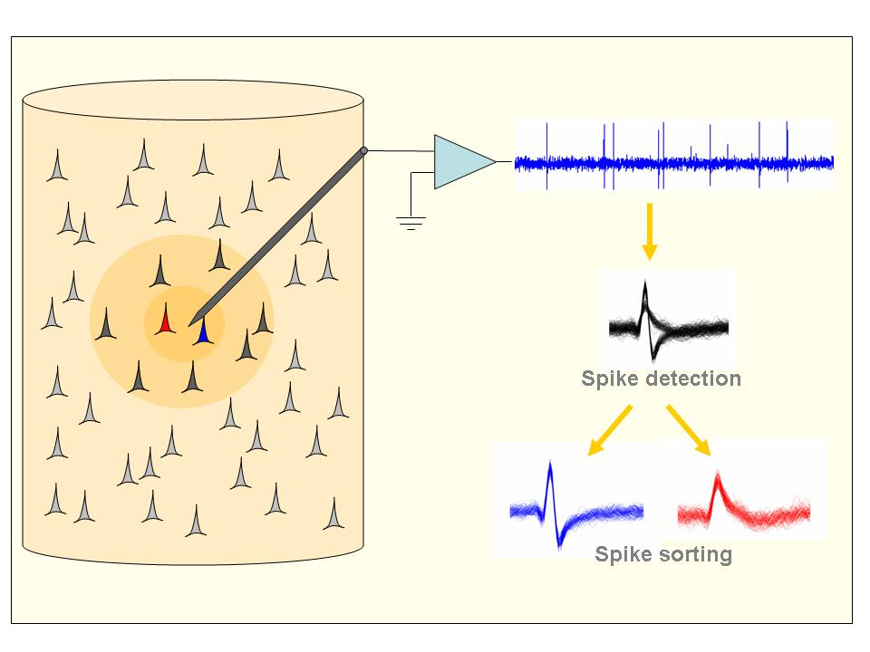

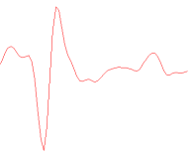
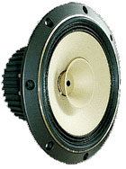
Data Acquisition
Extracellular recording
Electrode
Neuron
A Spike
Stimuli
Brain
Neuron Spikes

Slide 5
Spike Sorting
stimuli

Slide 6
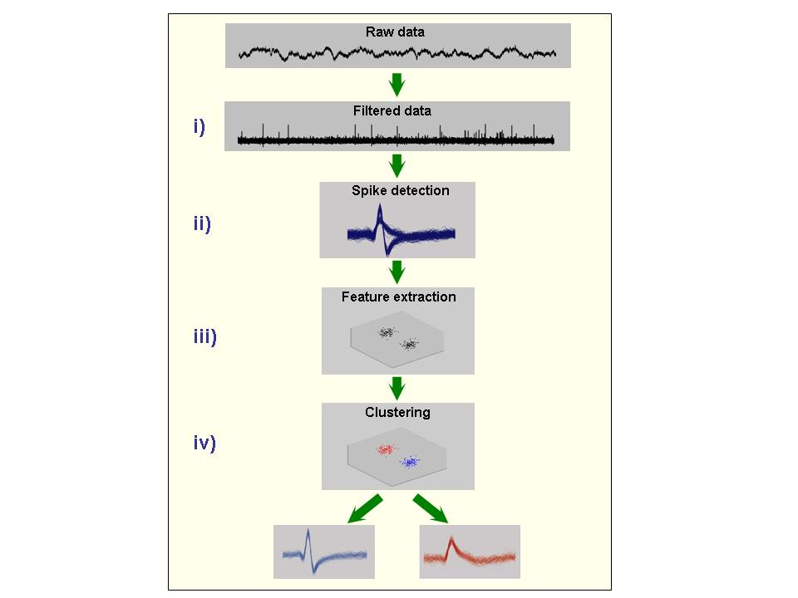
Spike Sorting
Band-pass filter
Threshold method
Feature extraction or selection
Clustering

Slide 7
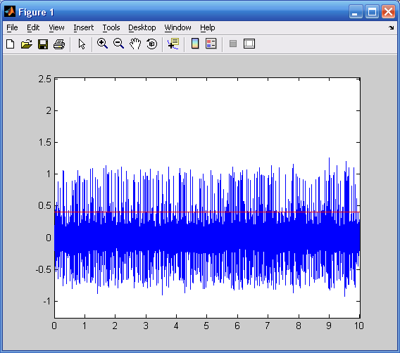
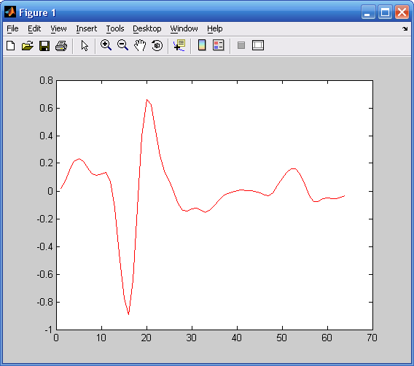
Spike Sorting
An example of a detected spike
Spike detection using a threshold value

Slide 8
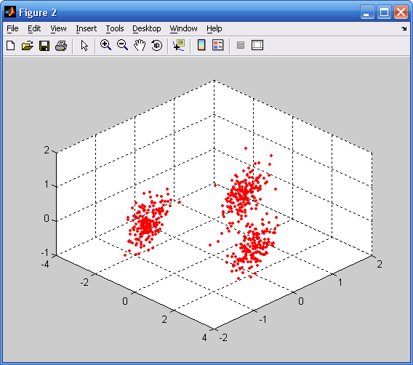
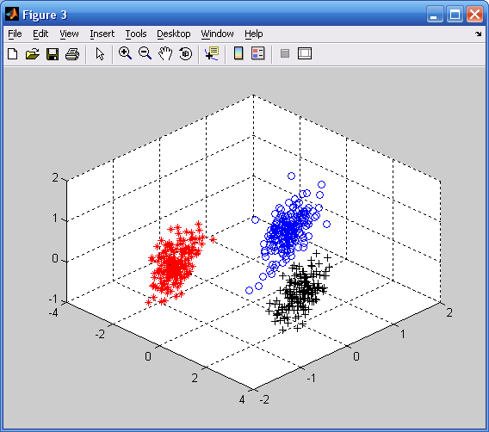
Spike Sorting
Result of clustering
3D view of spikes

Slide 9
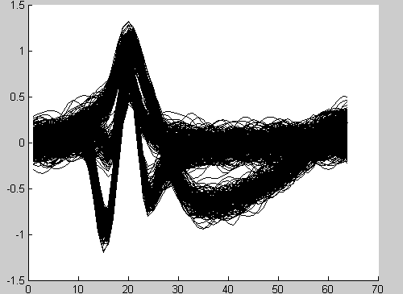
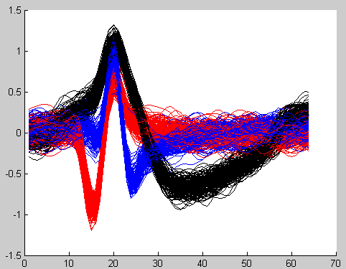
Spike Sorting
Unsorted spikes
Sorted spikes

Slide 10
Data
4 Datasets
  2 datasets for classification
    65 columns: 64(data) + 1(class information)
    Number of classes: 3(“1”, “2” and ”3”)
  2 datasets are for clustering
    64 columns: no column for class information
    Number of classes: not known
  Each dataset has around 3000 rows/spikes

Slide 11
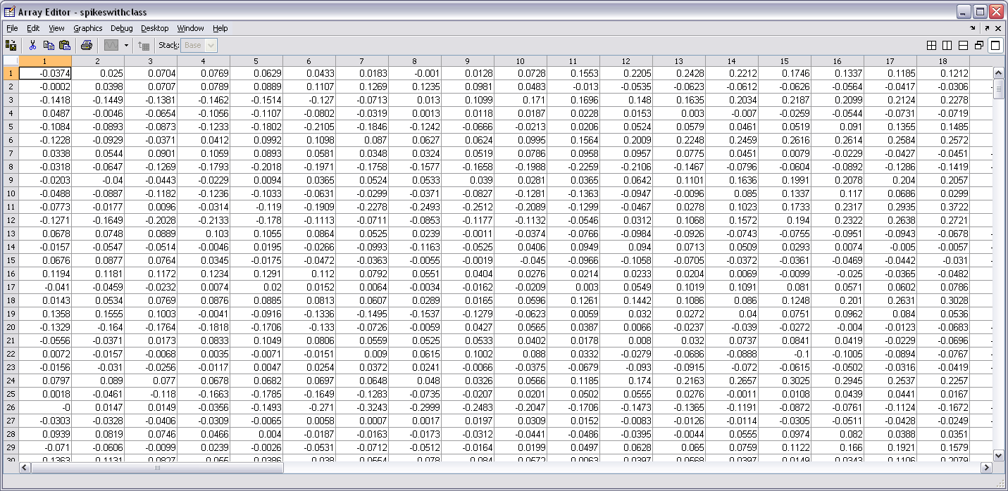
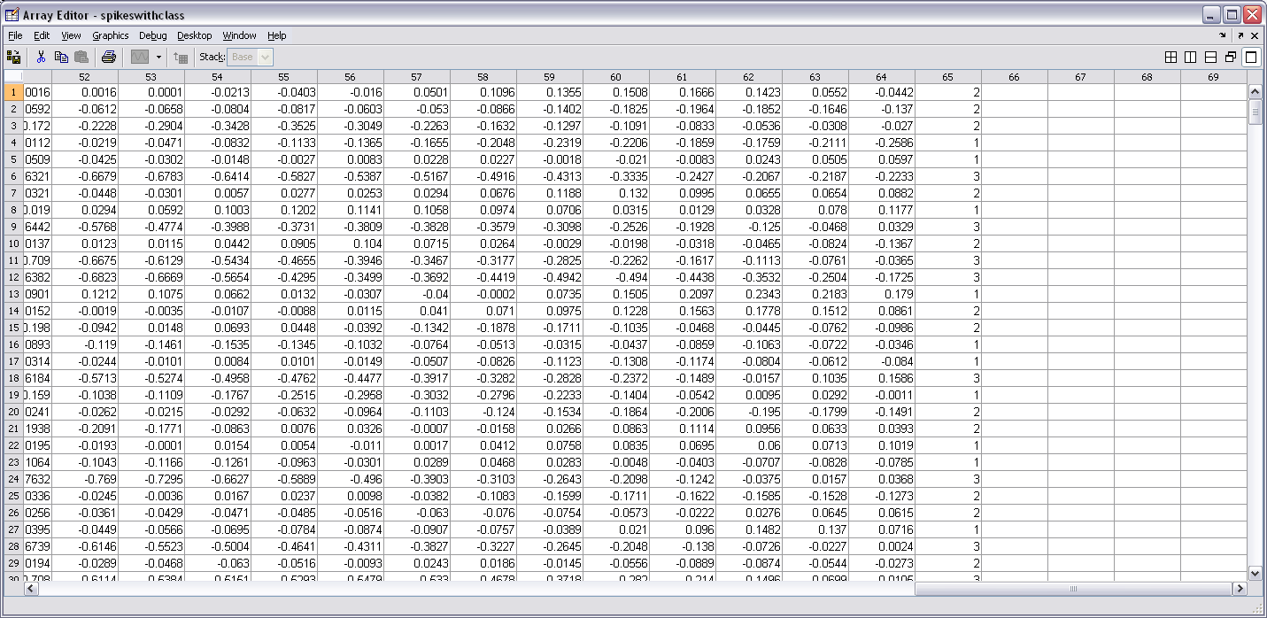
Example of data
64 Columns for a spike
Class information
….
….
….
About
3000
….

